Slide 1

Practical 3
Finding Next Greater Element (NGE)

Slide 2

Lesson Plan
Subject/Course | Competitive Coding
Lesson Title | Finding Next Greater Element (NGE)
Lesson Objectives
To understand the definition and importance of the Next Greater Element problem in programming and algorithm design.
To implement both brute force and efficient stack-based code to solve for the Next Greater Element in a given array.
To analyse and compare the time and space complexity of brute force and stack-based approaches.
To identify suitable scenarios in computer science or real-life where NGE solutions are applicable and efficient.

Slide 3
Problem Statement:
Write a program for finding NGE NEXT GREATER ELEMENT from an array.

Slide 4
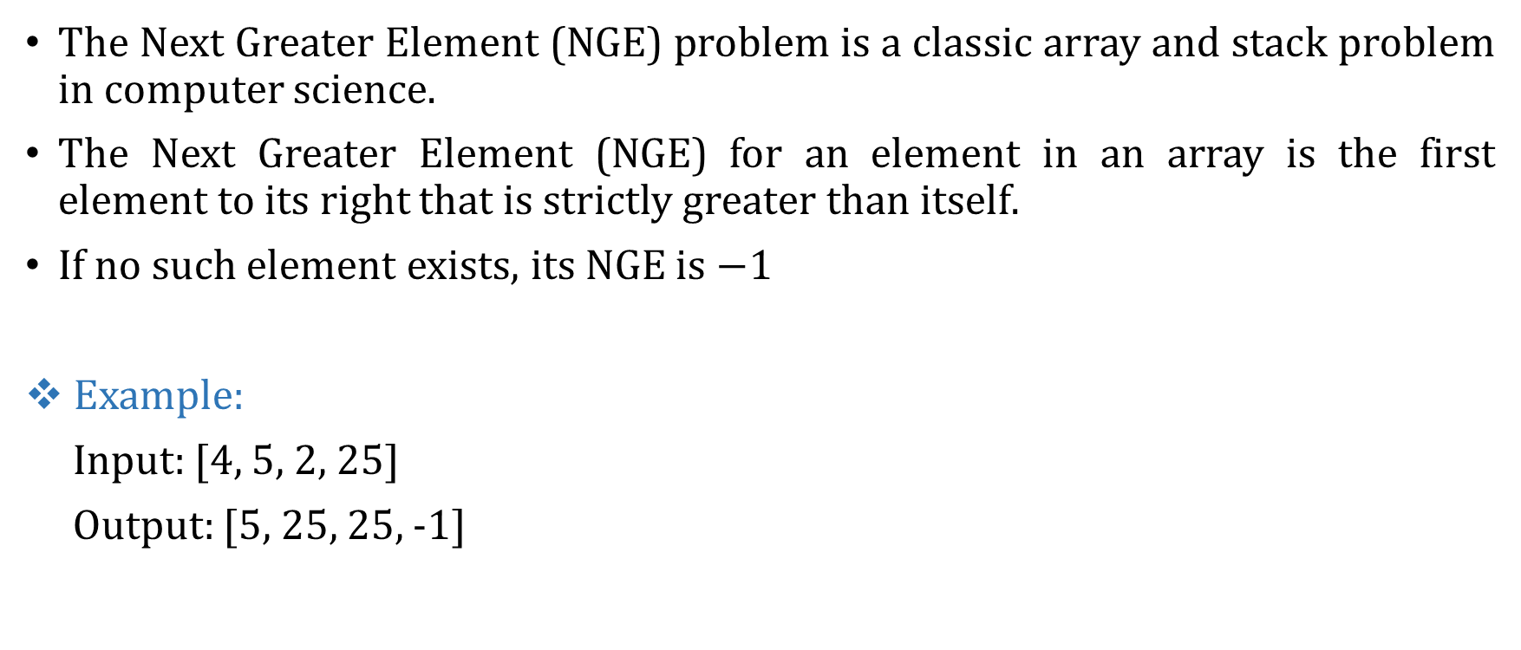
Introduction to the Problem
The Next Greater Element (NGE) problem is a classic array and stack problem in computer science.
The Next Greater Element (NGE) for an element in an array is the first element to its right that is strictly greater than itself.
If no such element exists, its NGE is $−1$
Example:
Input: [4, 5, 2, 25]
Output: [5, 25, 25, -1]

Slide 5
Concept and Background
• The Next Greater Element problem is important in data structure learning.
• It is used in stock span problems, temperature predictions, and interval analysis.
There are mainly two ways to solve this problem:
• Naive approach or brute force method
• Stack-based approach

Slide 6
Algorithm/Logic
Step 1: Initialize an empty stack. Use it to keep track of potential "next greater" candidates.
Step 2: Traverse the array from right to left.
Step 3: While stack is not empty and top ≤ current element, pop the stack.
Step 4: If stack is empty, NGE = -1; else NGE = top of stack.
Step 5: Push the current element into the stack.
Step 6: Continue until all elements are processed.

Slide 7
Visualization
Example: Let’s try to find NGE for all the elements present in the given array : arr = [6][8][0][1][3]
Step-by-Step Stack Approach We process array elements from right to left and maintain a stack where the potential next greater elements are stored.
Initialization
Stack: []
Result: [_, _, _, _, _]

Slide 8
Visualization
(A) i = 4, value = 3
Stack is empty. So, NGE for 3 is -1.
Push 3 to stack.
Result: [_, _, _, _, -1]
Stack: [3]
(B) i = 3, value = 1
Stack's top (3) > 1, so NGE for 1 is 3.
Push 1 to stack.
Result: [_, _, _, 3, -1]
Stack: [3][1]

Slide 9
Visualization
(C) i = 2, value = 0
Stack's top (1) > 0, so NGE for 0 is 1.
Push 0 to stack.
Result: [_, _, 1, 3, -1]
Stack: [3][1][0]
(D) i = 1, value = 8
Stack's top (0) ≤ 8; pop 0.
Next top (1) ≤ 8; pop 1.
Next top (3) ≤ 8; pop 3.
Now, stack is empty: NGE for 8 is -1.
Push 8.
Result: [_, -1, 1, 3, -1]
Stack: [8]

Slide 10
Visualization
(E) i = 0, value = 6
Stack's top (8) > 6, so NGE for 6 is 8.
Push 6.
Result: [8, -1, 1, 3, -1]
Stack: [8][6]
Final Answer: [8, -1, 1, 3, -1]

Slide 11
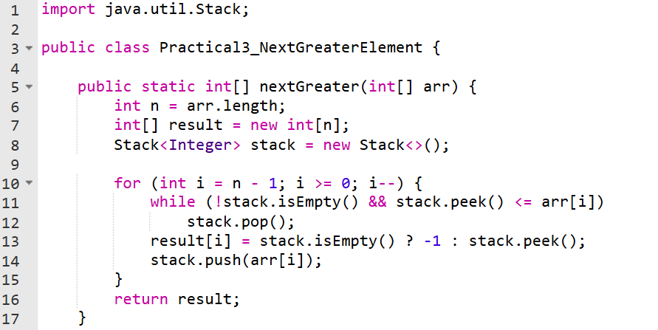
Code Implementation

Slide 12
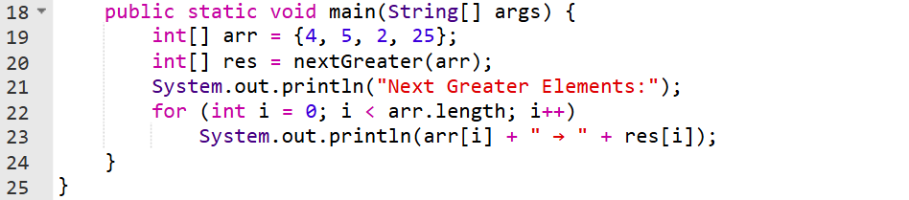
Code Implementation

Slide 13
Output :
Next Greater Elements:
4 → 5
5 → 25
2 → 25
25 → -1

Slide 14
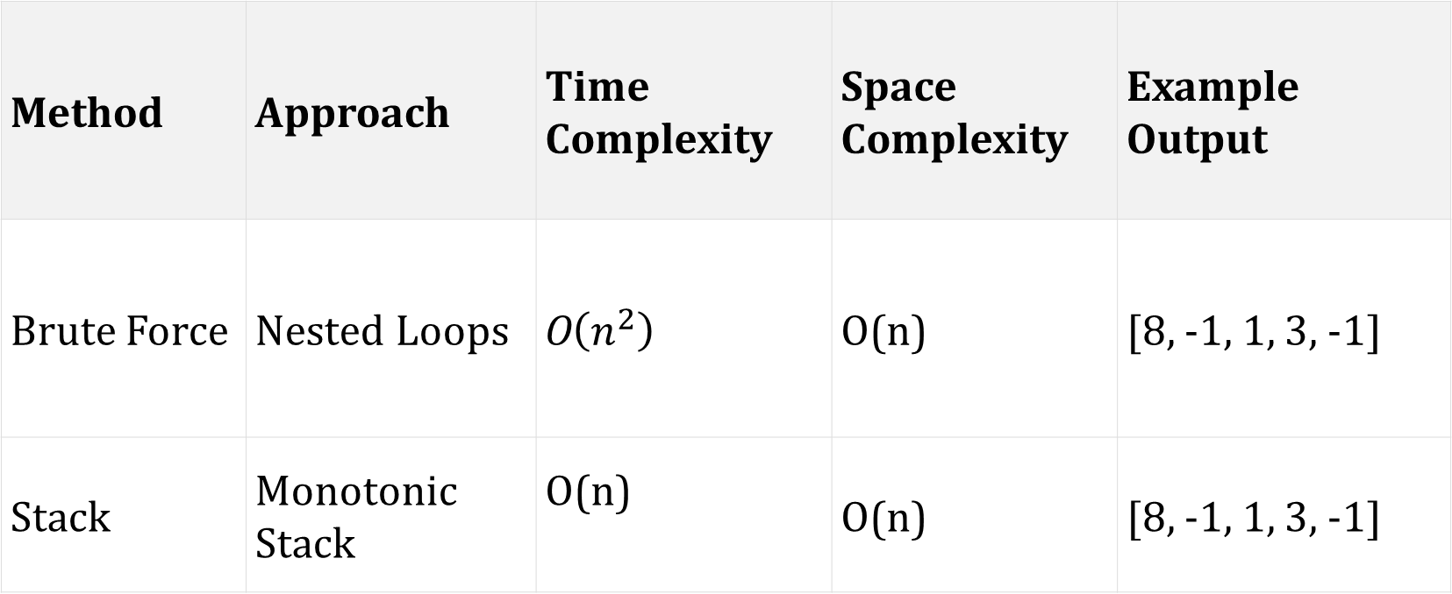
Time & Space Complexity
Method | Approach | Time Complexity | Space Complexity | Example Output
Brute Force | Nested Loops | O$\left(n^{2}\right)$ | O(n) | [8, -1, 1, 3, -1]
Stack | Monotonic Stack | O(n) | O(n) | [8, -1, 1, 3, -1]

Slide 15
Summary
Implemented a program to find the Next Greater Element for each element in an array.
Used a stack to efficiently track elements and determine the next greater value on the right side.
Improved efficiency from the brute-force O(n²) approach to an optimized O(n) solution.
Demonstrated the use of stack operations in solving array-based problems where relative ordering matters.
Reinforced understanding of LIFO behaviour and real-time element comparison in algorithmic problems.

Slide 16
Practice Questions:
1.Next Greater Element II (Problem 503):
🔗 https://leetcode.com/problems/next-greater-element-ii/
Concept: The "Next Greater Element II" problem extends the concept of finding the next greater element in a linear array to a circular array.
Why Practice: Same as our class example — perfect for reinforcement.

Slide 17
Practice Questions:
2.Next Greater Element III (Problem 556):
🔗 https://leetcode.com/problems/next-greater-element-iii/
Concept: The "Next Greater Element III" problem asks for the smallest integer greater than a given integer n that uses exactly the same digits as n, while fitting within a 32-bit integer; if no such number exists, return -1.
Why Practice: Strengthens your understanding of NGE problems logic.

Slide 18
Thanks

